Slide 1

Capturing Nevada’s Efficiency Potential in a Competitive Retail Electricity Market
By: Chris Neme
February 6, 2018

Slide 2
Energy Futures Group Consulting
EE/RE Areas of Expertise
Policy
Market Analysis
Program Design
Evaluation
Range of Clients
Regulators
Government Agencies
Advocates
Utilities
Clients in more than 25 states, 5 Canadian provinces, Europe & China.

Slide 3
Presentation Overview
Value of Efficiency as a Resource
Size of Cost-Effective Efficiency Resource
Need for Efficiency Programs
      Why consumers don’t invest in all cost-effective efficiency
      Why competitive electric market won’t change that reality
Options for Assigning Efficiency Program Obligations under Competitive Retail Electric Market

Slide 4
Value of Efficiency Resource

Slide 5
Multiple Benefits of Efficiency
Utility System Benefits
Energy
Generating Capacity
T&D infrastructure
Line losses
Environmental Compliance
RPS compliance
Credit & Collection Costs
Price Suppression
Lower risk
Other Consumer/Societal
Consumer Non-Energy Bens:
  Comfort
  Health & safety
  Building durability
  Water
  O&M
  Business productivity
  Etc.
Jobs/Economic Devt
Environment
Public Health
Energy Security

Slide 6
Efficiency as a Resource - Energy
Illinois Example (ComEd)
Savings targets imposed on distribution utilities
Spend ~4% of electric revenue on EE programs
To meet 20% of electric energy needs in 13 years
Massachusetts Example
Mandate to acquire “all cost-effective” efficiency
  Imposed on distribution utilities
Spend ~6% of electric revenue on EE programs
Will meet >20% of electric energy needs in 10 yrs

Slide 7
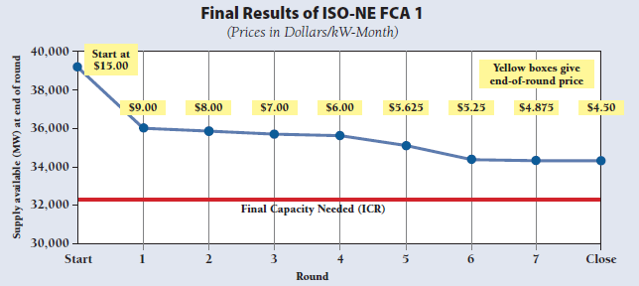
Efficiency as a Resource - Capacity
New England ISO Capacity Market Example
Demand resources (DRs), including EE, compete w/supply
11 annual auctions to date
DRs and EE have lowered market clearing prices
~2300 MWh of DRs cleared; without them market clears at ~$1/kW-month higher price

Slide 8
Efficiency as a Resource - Transmission
New England Example
ISO began integrating forecast EE into T planning in 2012
Cut >$400 million in planned T projects for just VT/NH
  Context: VT/NH population, GDP, electric sales all less than NV
Source: Chris Neme & Jim Grevatt (Energy Futures Group), “Energy Efficiency as a T&D Resource”, published by Northeast Energy Efficiency Partnerships, January 2015.

Slide 9
Efficiency as a Resource - Distribution
Con Ed (New York) Example
Passive Deferrals
Substation level forecasts of impacts
>$1 billion reduction in 10-yr forecast
Active Deferrals
>30 projects since 2003
RFPs for DERs, but mostly EE won
Many successful deferrals
Also hedge vs. forecast uncertainty – some projects never needed
Source: Chris Neme & Jim Grevatt (Energy Futures Group), “Energy Efficiency as a T&D Resource”, published by Northeast Energy Efficiency Partnerships, January 2015.

Slide 10
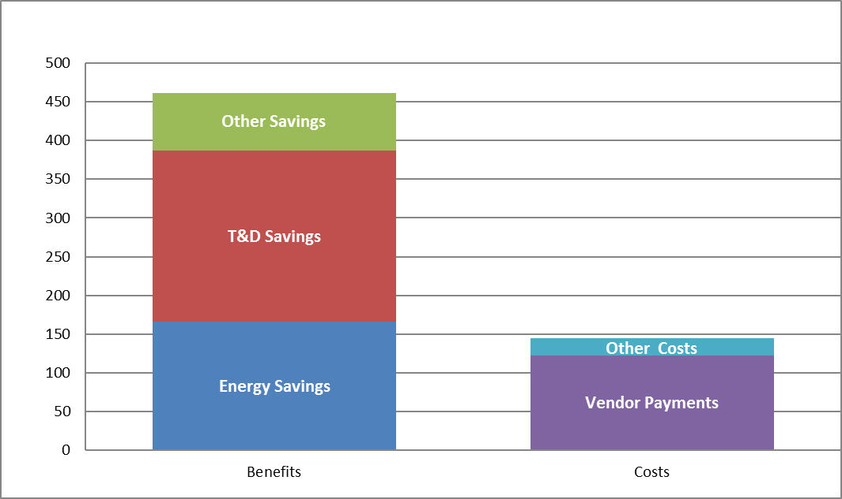
Con Ed Active Deferral Cost-Effectiveness
NPV of Net Benefits of Con Ed’s 2003-2010 Non-Wires Projects
(millions $)

Slide 11
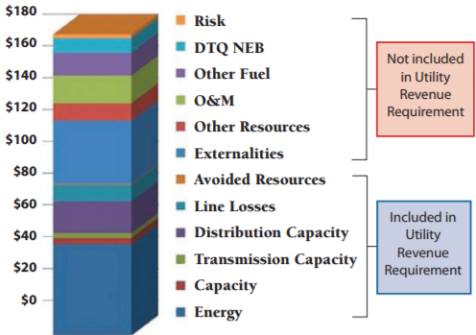
Vermont’s 2013 Estimated Value of Efficiency
($/MWh)
Source: Jim Lazar & Ken Colburn, “Recognizing the Full Value of Energy Efficiency”, Regulatory Assistance Project, Sept. 2013

Slide 12
Size of Efficiency Resource

Slide 13
Large, Untapped Potential
Studies typically estimate ~10-20% of energy use
But such estimates are inherently very conservative
  Don’t address all efficiency measures
  Don’t account for new technology
  Ignore transformational effects on markets
  Often assume artificial budget/policy constraints
  Etc.
30% likely possible in many/most jurisdictions

Slide 14
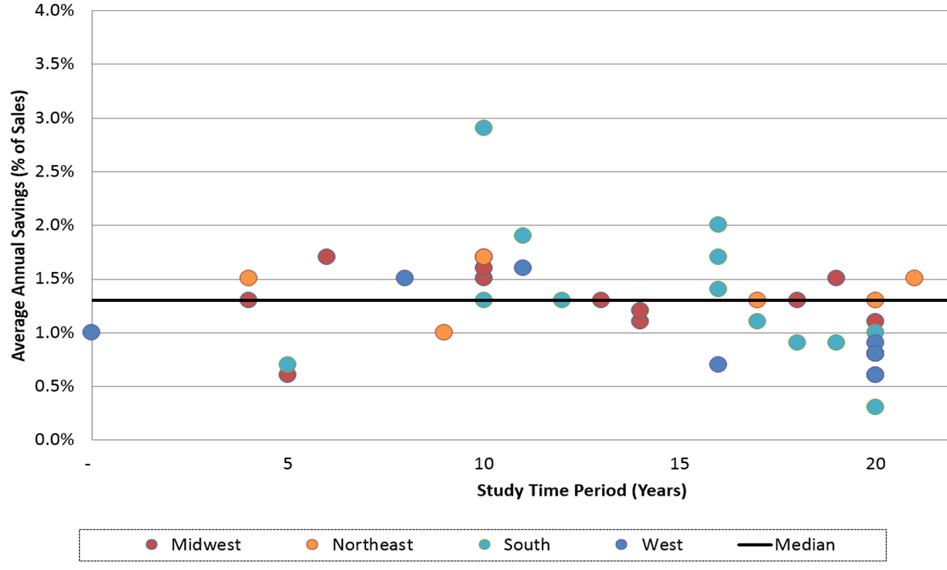



Estimates of Max Achievable Well Below Leading Jurisdictions’ Actual Achievements

Slide 15
The Bar Keeps Getting Raised
(annual electric savings as % of sales)
2006
≥2.5%: 0 states
≥1.5%: 0 states
≥1.0%: 3 states
≥0.5%: 12 states
2016
≥2.5%: 3 states
≥1.5%: 6 states (incl. CA, WA)
≥1.0%: 16 states (incl. AZ, ID)
≥0.5%: 28 states (NV: 0.6%)
6 states have EERS ≥2.0% savings in the future (incl. AZ)
Sources: ACEEE 2008 and 2017 State Energy Efficiency Scorecards

Slide 16
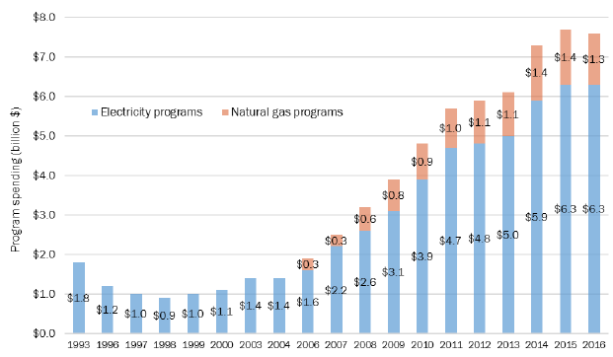
Increasing National Expenditures
Source: ACEEE 2017 State Energy Efficiency Scorecard

Slide 17
Low Costs of Savings (1)
Typical program cost ~2-3 cents per kWh saved
Most aggressive states ~3-5 cents per kWh saved

Slide 18
Need for Efficiency “Programs”

Slide 19
Numerous Market Barriers
Awareness/info
  Consumers
  Builders, vendors, suppliers, contractors, etc.
Split incentives
  Builders vs. future occupants
  Owners vs. tenants
Risk/Uncertainty regarding efficiency performance
  Individual customer choice vs. portfolio of EE measures/participants
Transaction costs
Different planning horizons for demand than for supply
Lack of access to capital
Energy prices don’t align with costs

Slide 20
Will Retail Choice Change Barriers?
Won’t directly change them
Only indirectly if efficiency offers used to attract customers
  No evidence to suggest this will be the case
  And only even possible for some efficiency measures
    Only retrofit measures
    No effect on time of purchase, new construction measures
In UK, residential insulation market collapsed once requirements for retail energy suppliers to acquire energy savings was eliminated (i.e. once it was made optional).

Slide 21
Need to Obligate an Entity to Acquire EE
Significant cost-effective efficiency will be “left on the table” without a mandate
That’s true regardless of market structure
  Vertically-integrated utility or
  Retail choice
“Someone” needs to be obligated to acquire EE

Slide 22
Options for Efficiency Obligations under Retail Choice

Slide 23
3 Primary Options
Distribution Utility
  IL, MA, OH, CA, etc.
Independent 3rd Party
  NJ, OR
Retail Energy Suppliers
  UK, France

Slide 24
Distribution Utility
Pros
Serves all customers
  Full range EE programs
  Market clarity
Customer relationships
Customer data access
Regulated investments EE helps address
Cons
Not “core business”
Monopoly has less incentive for innovation

Slide 25
Independent 3rd Party
Pros
Serves all customers
  Full range EE programs
  Market clarity
Singular focus
Competition can drive innovation
Cons
No customer relationships
No customer data
Note: Assumes competitive selection process, but there are other variations.

Slide 26
Retail Energy Suppliers
Pros
Some customer data
Some relationships
EE can be marketing tool
Pressure to minimize costs
Cons
Only some customers
  Limits EE program options
  Creates EE mkt confusion
  Puts upward pressure on EE program costs
Not “core business”
Mix
Some customer data, but not all
Some customer relationships, not all

Slide 27
Doesn’t Competition Lower Cost?
Yes, but for whom?
Increased competition for customers, savings…
  results in increased offers (e.g. rebates) to customers
Lowers net cost to participating customers…
  but increases program costs for ratepayers as a whole

Slide 28
Can “Cons” Be Addressed?
Distribution Utility Model
Not core business
Monopoly disincentive to innovate
Independent 3rd Party
No customer data
No existing customer relationships
Retail Energy Suppliers
Serve only some customers
  Limited program options
  Market confusion
  Increased EE program costs
Not core business
Shareholder incentives, tied to performance
Decoupling (NV already)
Can make available
No short-term solution; goes away over long-term
No obvious solution

Slide 29
Recommendations (1)
Establish an Energy Efficiency Resource Standard
  Statutorily set targets or require PUC to set them
    i.e. moved out of current context of resource planning
    but still driven by concept of EE as a resource alternative
  Targets should be:
    Approximately = max that is cost-effective (as under SB 150)
    Multi-year
    Expressed in ways that reward longer-lived savings
  Need to obligate entity to meet standards

Slide 30
Recommendations (2)
EE Obligation on Distribution Utility or 3rd Party
  Do not impose on retail energy suppliers
  They can still supplement DU/3rd party if they choose
Create performance incentives
  Most important for DU, but helpful for 3rd Party too
  Many different ways to do this
Independent evaluation
  Particularly important w/performance incentives

Slide 31
Recommendations (3)
Decoupling
  NV already has
IRP/least cost approaches for D Investments
  Additional geo-targeting of EE, on top of system-wide
  Several jurisdictions now do this…
  …including NV starting in 2020

Slide 32
Q&A
Chris Neme
Energy Futures Group
cneme@energyfuturesgroup.com
Phone: 802-482-5001 ext. 1
Cell: 802-363-6551

Slide 33
Extras for Reference (if needed)

Slide 34
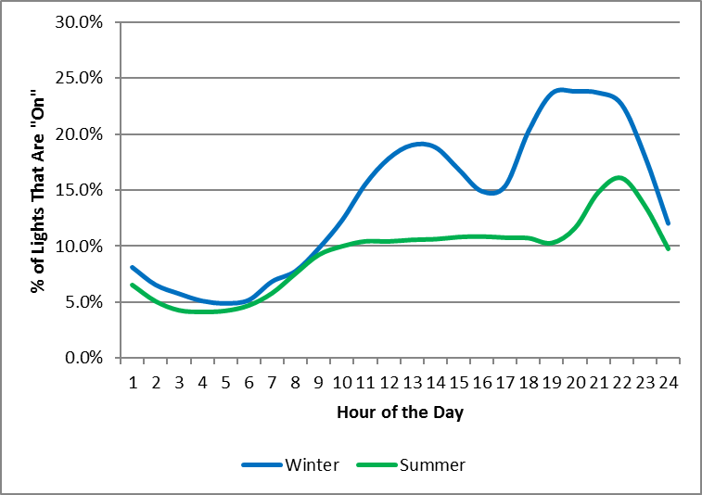
Most EE Programs Provide Some Savings at All Hours of Potential Interest
Residential Lighting Savings Load Shape

Slide 35
Comparative Reliability of EE Capacity
(Current ISO New England Data/Assumptions)
Demand Resources
Efficiency: 100%
Demand Response: 90%
Total System: 98%
Generators
Combined Cycle: 96.1%
Fossil: 80.7%
CT: 89.6%
Nuclear 98.1%
Hydr o 96.5%
Diesel 90.7%
Misc. 90.7%
Total System 92.7%

Slide 36
Efficiency as a Resource – T&D
Passive Deferrals
Indirect, long-term impacts system-wide programs
Active Deferrals
Geographically-targeted programs intentionally designed to defer specific T&D projects

Slide 37
Depth of Savings Matters
Hypothetical Distribution Substation w/100 MW Capacity

Slide 38
Season & Hour of T&D Peak Matter

Slide 39
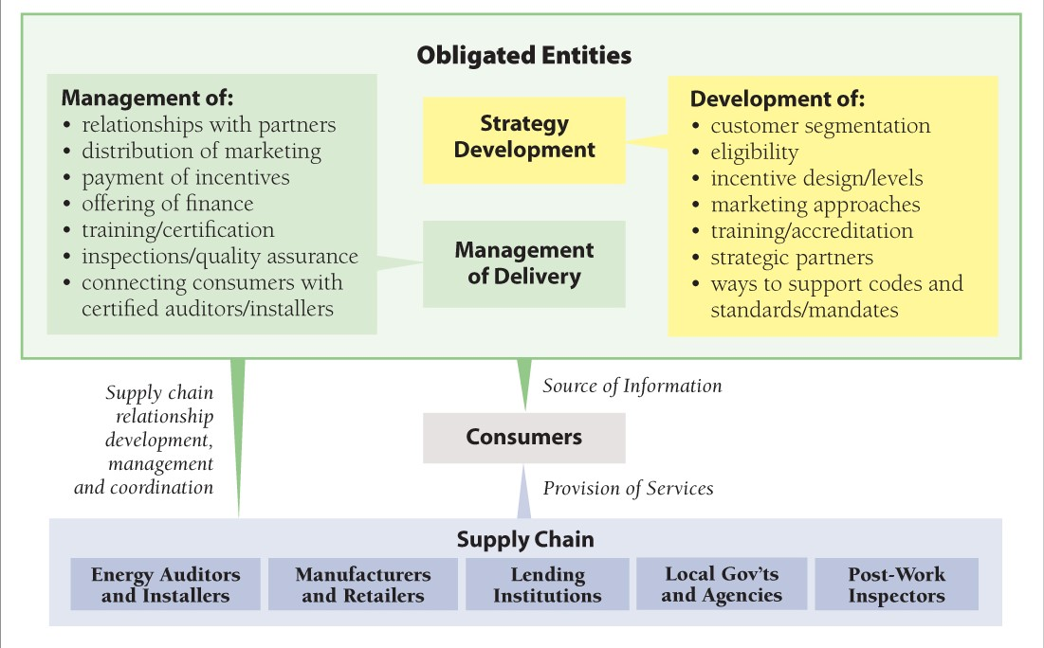
Concept of “Obligation”

Slide 40
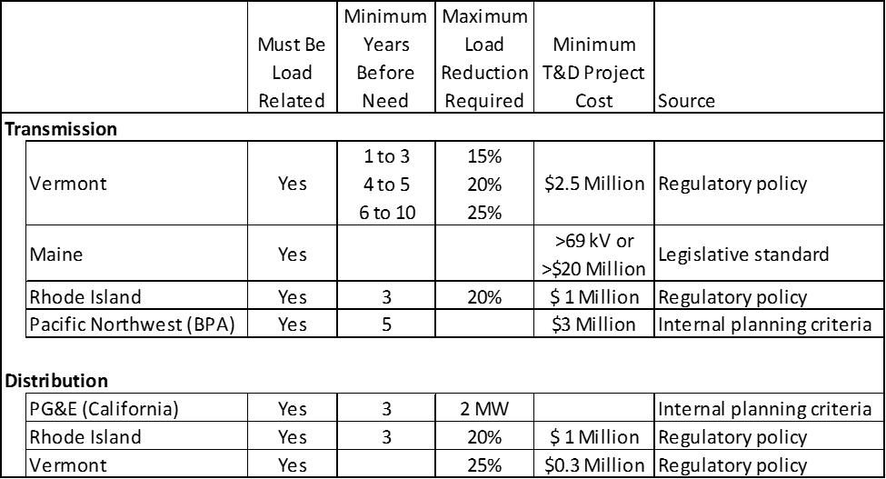
Institutionalizing Non-Wires Alternatives
2015 Screening Criteria for Triggering Detailed Assessments of NWAs

